Slide 1
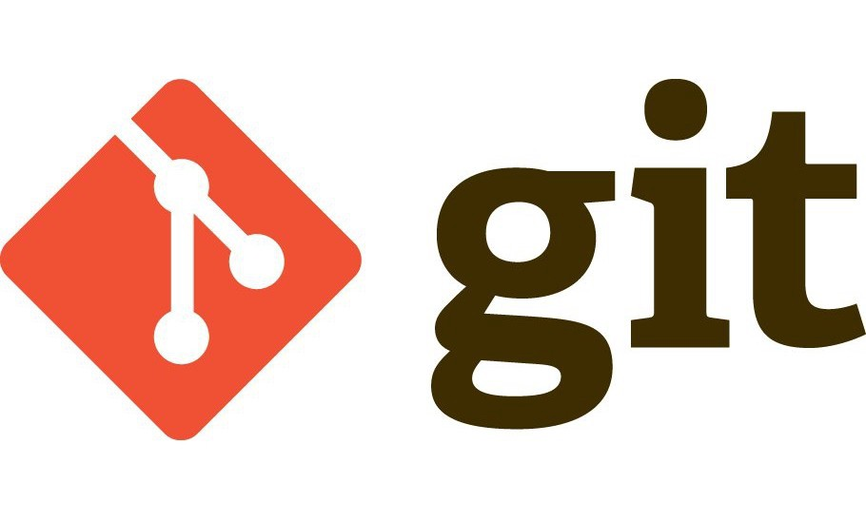
Git, Github, and Version Control

Slide 2

Version Control
How do I save and backup files on a project?

Slide 3
Version Control
How do I save and backup files on a project?
final.py
Final2.py
final_final.py
final_final_v3.py
REALLYFINAL.py
Final_Serious_This_Time.py
Restart_because_it_broke.py

Slide 4

Git was created for Version Control
Saving projects
Creating a folder (repository) holding project information
Ability to return to previous states of the project
Multiple people can work on a project by “branching” the project
Logging who changed what
Encourage documentation

Slide 5
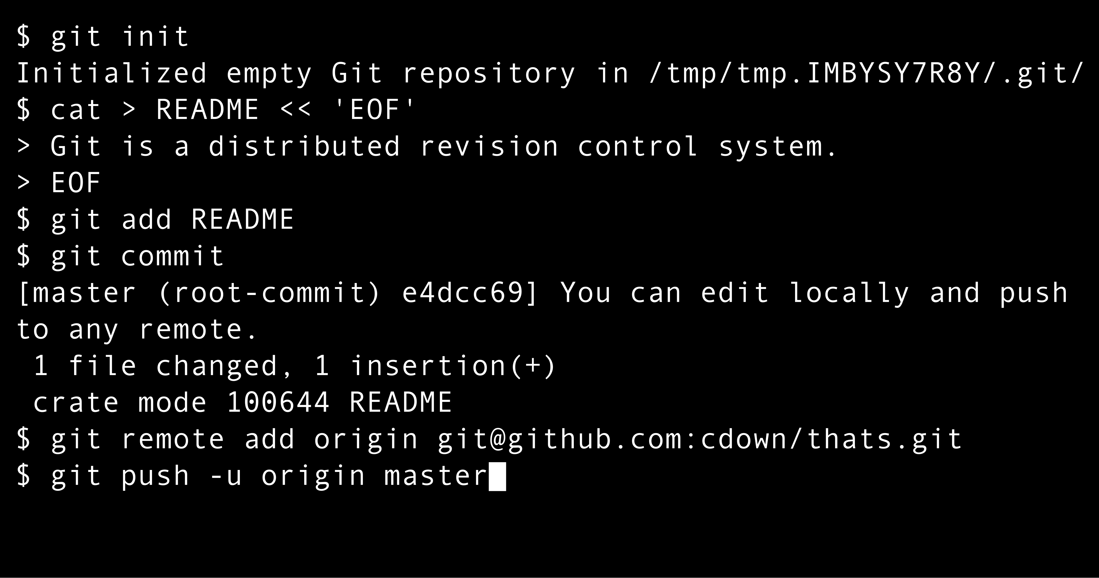
Git
Done through command line
Open source
Developed by Linus Torvalds
Man behind Linux

Slide 6
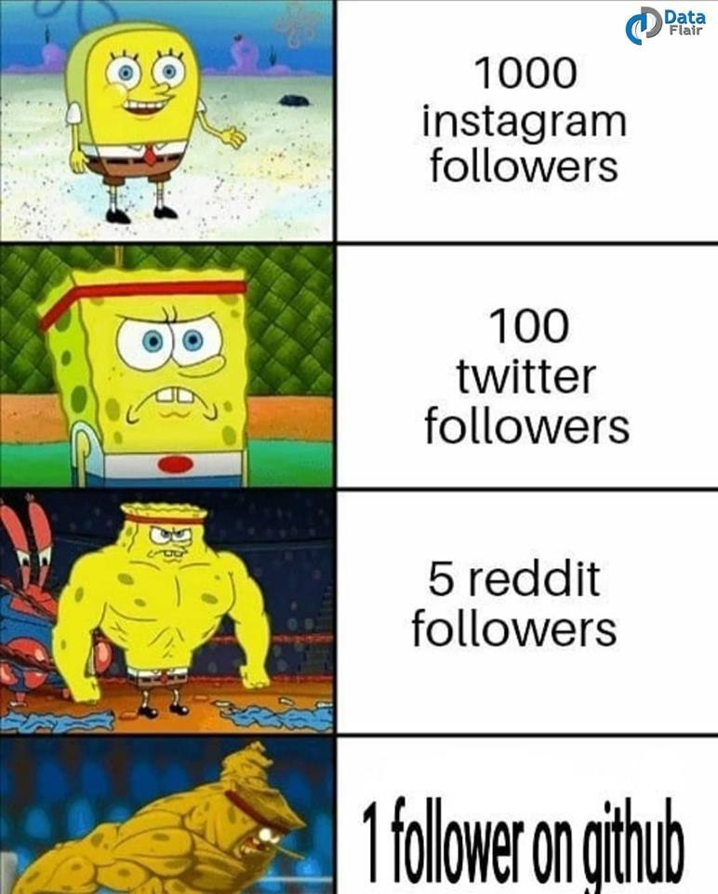
Github
GUI and social hub for Git
Git (the tool) vs GitHub (the platform)
GitHub allows you to:
• store repositories online
• collaborate with others
• share projects
• contribute to open source
• create a portfolio of projects

Slide 7

Basic Github terms and commands
Repository (repo)
Add and Commit
Branch and Pull Request

Slide 8

Repository (repo)
A repository (repo) is a folder tracked by Git.
Example:
calculator_project/
calculator.py
README.md
requirements.txt
Git tracks every change inside the repo.

Slide 9

Add and Commit
Add new files to the repo
Change files within the repo
Commit: confirm changes in repo (save changes)

Slide 10
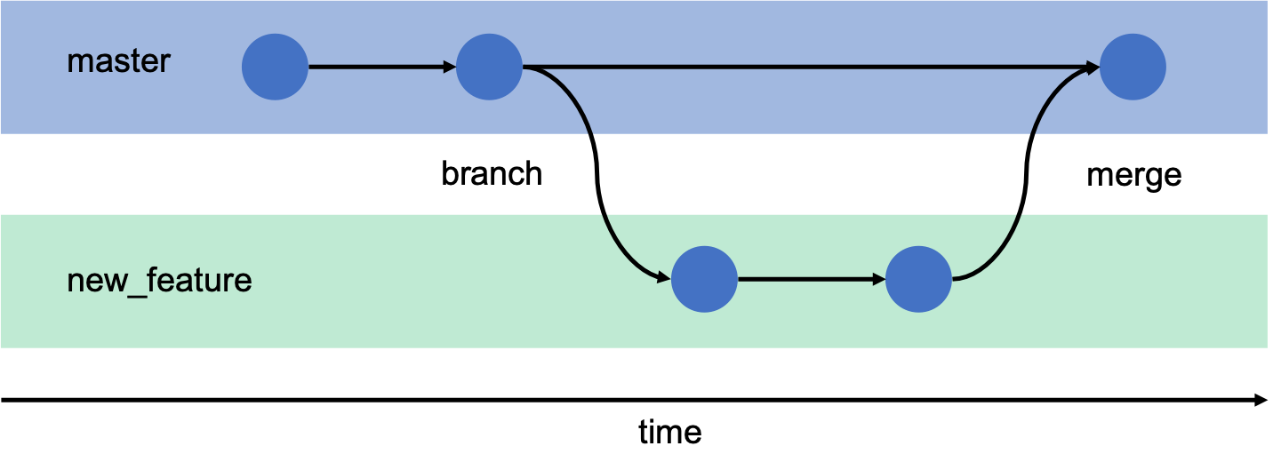
Branch
Create a fork or copy of main/master path
Edit and add without effecting main path
Until.. pull request or merging branch and main
Owner has to accept change

Slide 11

Basic workflow of GitHub
1. Edit code
2. Add changes
3. Commit changes
4. Push to GitHub
Each commit represents a snapshot of the project.

Slide 12
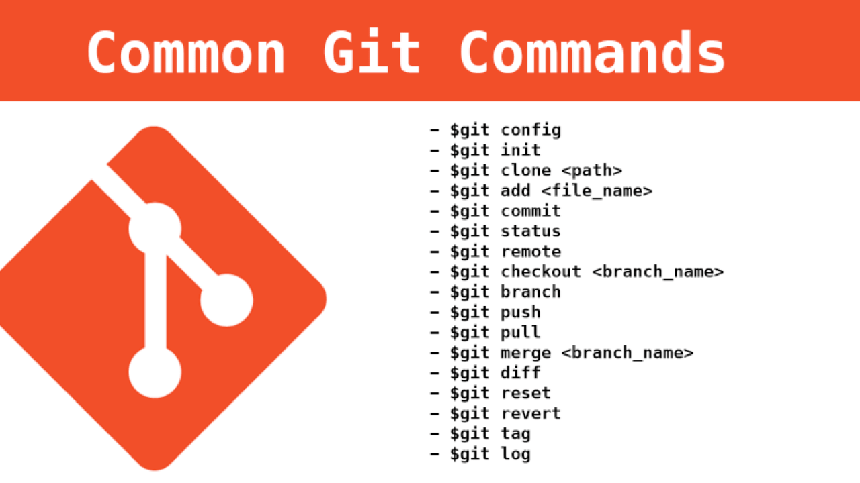
Some Git commands
Important ones for beginners:
git add
git commit -m "message“
git push

Slide 13
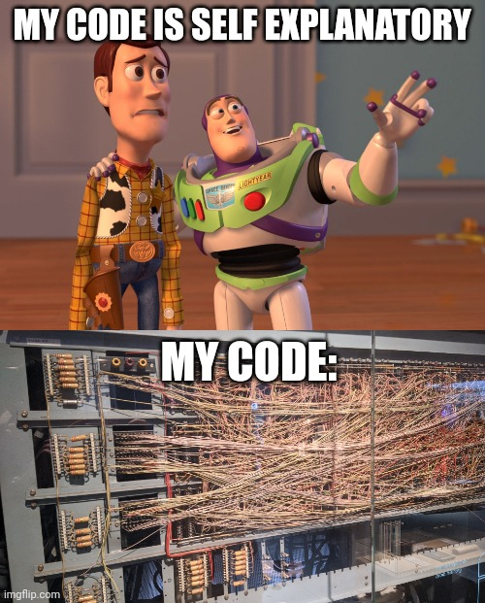
The Importance of README Files (Documentation)
Typical README sections:
Project description
Installation instructions
Usage
Author

Slide 14
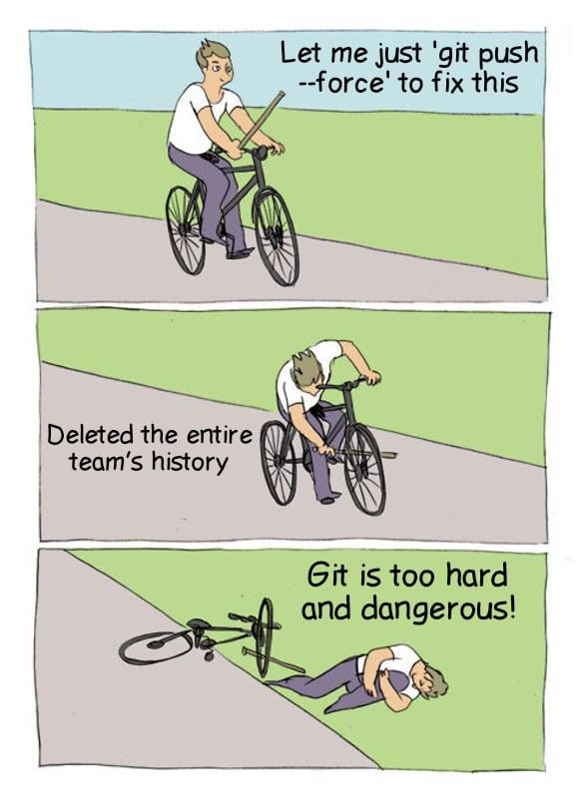
Common Beginner Mistakes
Common issues:
forgetting to commit
poor commit messages (for logging changes)
uploading unnecessary files
Good commit message: 'Fix login validation bug'

Slide 15
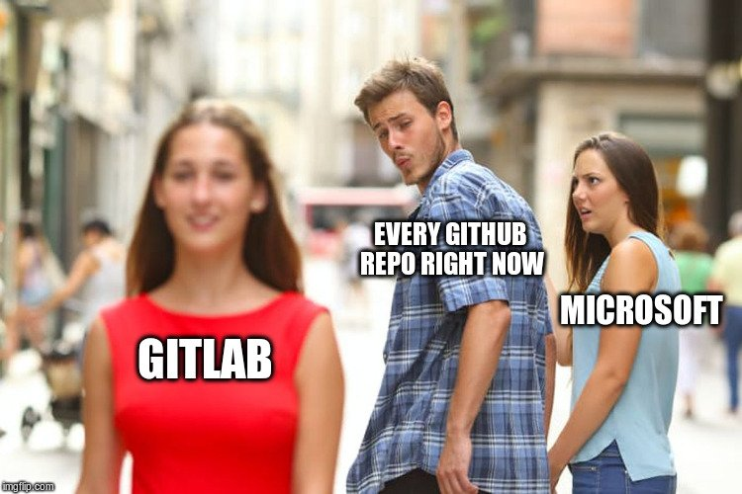
GitHub in Industry
Most software teams use Git-based workflows.
Common platforms:
• GitHub (bought by Microsoft)
• GitLab
• Bitbucket
Git is an industry standard.

Slide 16
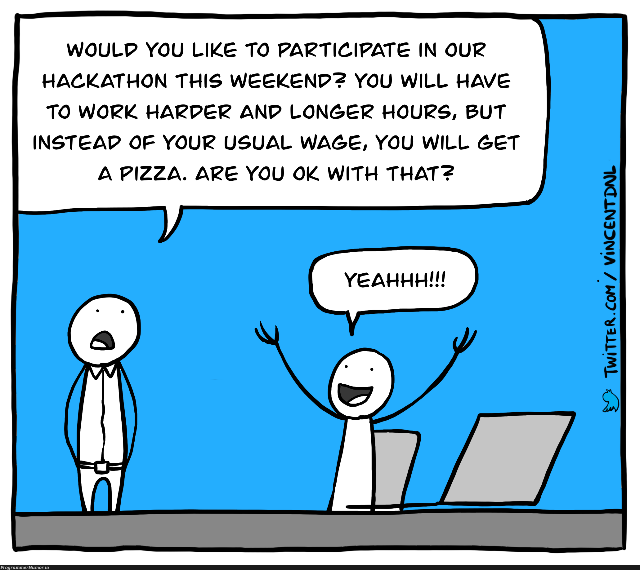
GitHub and Hackathons
Used to judge code and Readme
Common errors:
API passwords in public
Merging 5 minutes before submission

Slide 17
Let us set up GitHub and check out some features

